Slide 1


Helping your child to stay health, safe and thrive in the modern world
Seaford Head School
Notes:
Thank you for viewing this power point. You are experts on your child and we are keen to share what is planned for our new programme of RSHE so you can be informed and share your views.

Slide 2
The world has changed…
Internet access to adult content
Gaming addiction
Sexualisation of society
Online bullying
Online exploitation
Gangs
Knife crime
Extremism
Fake news
Notes:
You might be wondering why the government has decided to make the topics of relationships education, sex education and health education statutory for all schools.
If you reflect on your own memory of relationships and sex education from when you were at school, it is likely that it was too little, too late and too biological. Not enough has changed to improve this today. The current guidance is 20 years out of date and a lot of has changed in that time. To help children and young people be safe, happy and healthy in the modern world, they need the information, values and skills, taught sensitively in an age and stage appropriate way to navigate the risks and take advantage of the opportunities available to them.
Research shows that effective teaching of relationships and sex education has a positive impact on children and young people. They are:
More likely to report sexual abuse, delay first sex until they are ready, engage in consensual sex, use contraception and condoms and less likely to have unplanned pregnancy or sexually transmitted infection.
The top three preferred sources of sex education for young people are: school, parents and health professionals.
bring the new guidance int We are going to start by reminding ourselves about some of the things that our children/young people are exposed to...
You may not have these magazine and computer games in your home, but your child may still see things like this in shops, other people’s homes etc.
From June 2019, under new rules, British companies will no longer be able to create promotions that depict men and women engaged in gender-stereotypical activities, amid fears that such depictions are contributing to pay inequality and causing psychological harm.
Adverts will no longer be able to show a person failing to achieve a task specifically because of their gender, such as a man unable to change a nappy or a woman unable to do DIY/park a car.
The rules will also ban adverts that suggest that transforming your body will make you romantically successful, while also clarifying rules on the sexualisation of young women.

Slide 3
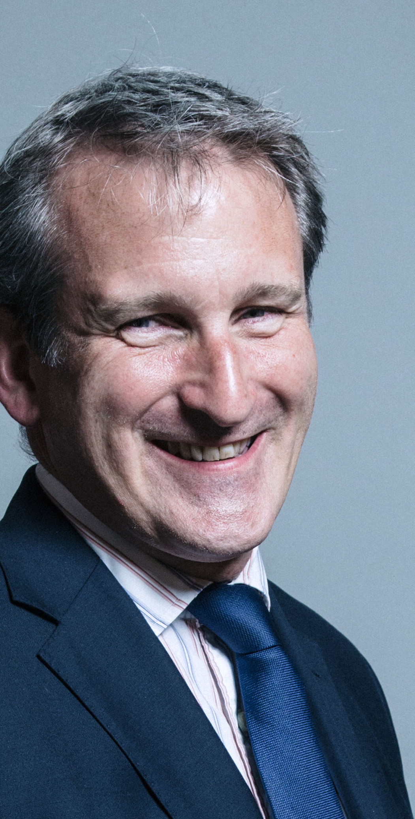
Secretary of State Foreword
“Today’s children and young people are growing up in an increasingly complex world and living their lives seamlessly on and offline. This presents many positive and exciting opportunities, but also challenges and risks. In this environment children and young people need to know how to manage their academic, personal and social lives in a positive way”.

Slide 4
Our school vision for RSHE
At Seaford Head School, we recognise the importance of high quality RSHE which supports young people to lead safe and healthy lives into adulthood.
RSHE is an entitlement for all young people.
We believe that its delivery should be inclusive, taking into account young people’s age, gender, learning needs, health, culture, family circumstances and sexuality.
RSHE at Seaford Head School will seek to enable young people to gain information and explore attitudes and values.

Slide 5

SECONDARY RELATIONSHIPS AND SEX EDUCATION
Schools will be required to teach…
Families
Respectful relationships, including friendships
Online and media
Being safe
Intimate and sexual relationships, including sexual health.
Notes:
From September 2020, all secondary schools in England will be required to teach a curriculum of relationships education. This includes:
Families
Respectful relationships, including friendships
Online and media
Being safe
Intimate and sexual relationships, including sexual health
‘The aim of RSE is to give young people the information they need to help them develop healthy, nurturing relationships of all kinds. It should also cover contraception, developing intimate relationships and resisting pressure to have sex (and not applying pressure). It should teach what is acceptable and unacceptable behaviour in relationships. It should teach young people to understand human sexuality and to respect themselves and others’.
We are proud to have been teaching much of this already as part of our broad and balanced curriculum. The new guidance will not therefore require us to do lots more or much differently, but we are using it as an opportunity to build on our existing foundation of good teaching and learning and to make further improvements.
Our newly planned curriculum overview is available for you to see and we look forward to hearing your views on this.

Slide 6
HEALTH EDUCATION
Schools will be required to teach…
Mental wellbeing
Internet safety and harms
Physical health and fitness
Healthy eating
Drugs, alcohol and tobacco
Health and prevention
Basic first aid
Changing adolescent body
Notes:
Additionally, from September 2020 all schools in England will be required to teach a programme of Health Education. This includes:
As well as being listed as an explicit topic, mental wellbeing will form an integral part of many of the lessons.
As with relationships education, we are proud to have been teaching much of this already as part of our broad and balanced curriculum. The new guidance will not therefore require us to do lots more or much differently, but we are using it as an opportunity to build on our existing foundation of good teaching and learning and to make further improvements.
Our newly planned curriculum overview is available for you to see on the next slide and we look forward to hearing your views on this.
Parents have no right to have their child excused from any aspect of relationships education or health education.

Slide 7
Curriculum: Relationships and Sex Education
Secondary content – core areas:
Families
Respectful relationships, including friendships
Online and media
Being safe
Intimate and sexual relationships, including sexual health
‘The aim of RSE is to give young people the information they need to help them develop healthy, nurturing relationships of all kinds. It should also cover contraception, developing intimate relationships and resisting pressure to have sex (and not applying pressure). It should teach what is acceptable and unacceptable behaviour in relationships. It should teach young people to understand human sexuality and to respect themselves and others’.
Notes:
These are the core areas of the relationships and sex education curriculum that the government has set schools to teach. Each core area has a number of outcomes within it.

Slide 8
Curriculum: Health Education
‘It is important that the starting point for health and wellbeing education should be a focus on enabling pupils to make well-informed, positive choices for themselves. They should know that there is a relationship between good physical health and good mental wellbeing and that this can also influence their ability to learn’.
Mental wellbeing
Internet safety and harms
Physical health and fitness
Healthy eating
Drugs, alcohol and tobacco
Health and prevention
Basic first aid
Changing adolescent body
Notes:
These are the core topics that all schools have to teach under the health education.
Schools have flexibility to enhance the curriculum, particularly in response to identified need.

Slide 9

Your children want to learn…
Notes:
To help us plan a relevant, needs-led programme of relationships, sex and health education, we have done our own sensitive, age and stage appropriate pupil voice work.
What you can see on the slide now are the top topics that our children told us were most important to them. We have taken this into account when planning our curriculum.
You may like to talk to your child yourself, so you can use their views to inform your own when responding to our consultation process.

Slide 10
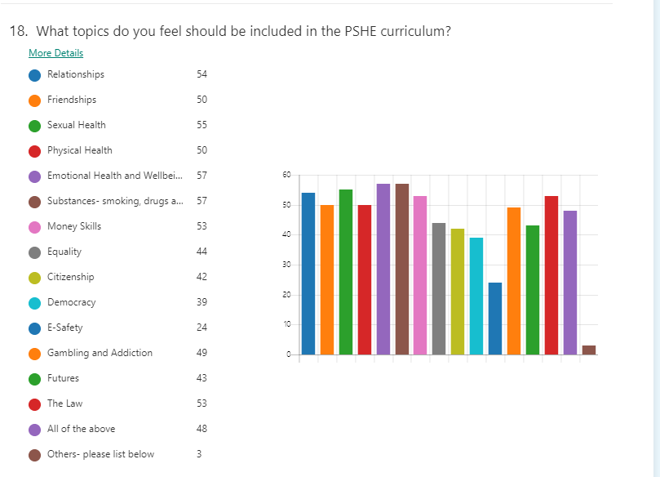

Slide 11
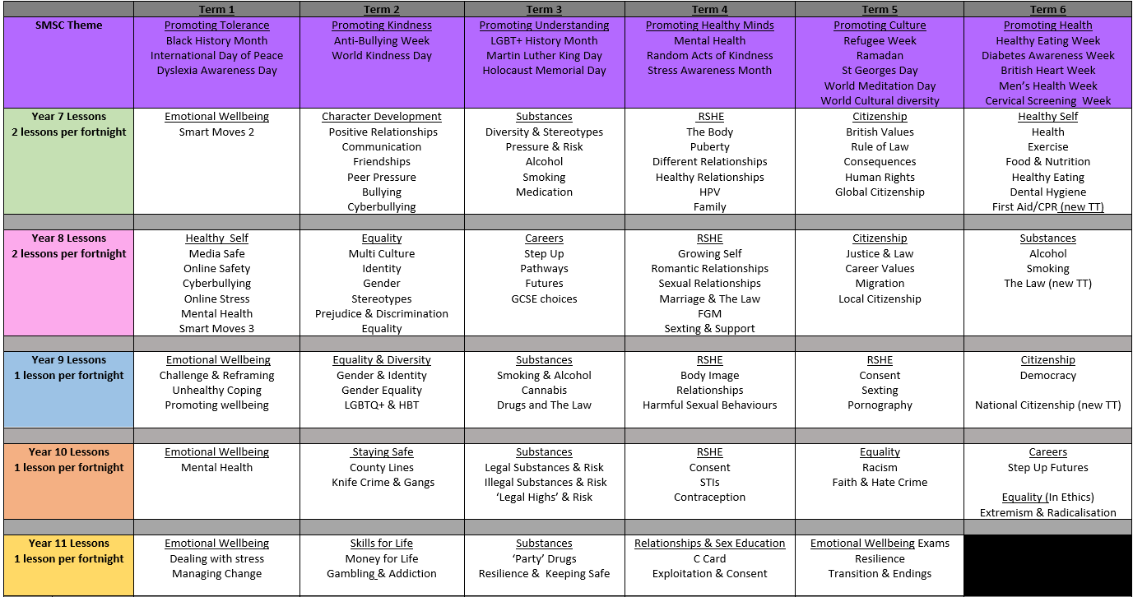
PSHE Curriculum 2021-2022

Slide 12
Your views…
https://forms.office.com/r/T1tdMKt8BW

Slide 13
How our school will teach this…
Each class will create a working agreement so pupils feel comfortable to join in the lessons;
All teachers will use correct scientific language when talking about parts of the body;
No pupil will be forced to join in an activity, or answer a question;
All genders taught together;
Teachers have been support to teach these lessons;
Teachers are unlikely to, and pupils not be asked to share personal experiences;
All causes for concern raised as a result of the lessons will be dealt with according to the school safeguarding policy.
Notes:
Discuss any other factors relevant to the approach or delivery of RSE teaching at the school. For example, sensitive to faith perspectives

Slide 14

Top tips for talking to your child…
Use everyday opportunities
Be calm and relaxed
Really listen
Notes:
RSE will be taught according to statutory requirements, and inline with the ethos of the school and the framework of the school RSHE policy. It will be taught using inclusive resources in a non-judgemental way. It is important that as a family you take the time to share your personal values, beliefs and attitudes as relevant to the topics and also to create strong channels of communication with your child as early as possible.

Slide 15
Parental right to have your child excused
No right to withdraw from relationships education, health education or sex education taught within the national curriculum for science.
If you wish to have your child excused from some or all elements of sex education, you will need to meet with the head teacher to discuss. An appointment can be arranged by contacting:
head@seafordhead.org
Requests will be granted except in exceptional circumstances
Pupils can override this 3 terms before their sixteenth birthday to access a sex education curriculum in their last year of school.
Notes:
Parents have the right to request that their child be withdrawn from some or all of sex education delivered as part of statutory RSE, but not from sex education taught as part of the national curriculum for science.

Slide 16

These subjects represent a huge opportunity to help our children and young people develop. The knowledge and attributes gained will support their own, and others’, wellbeing and attainment and help young people to become successful and happy adults who make a meaningful contribution to society.

Slide 17

If you would like to discuss the PSHE & RSHE provision further please contact
Sam Whittaker samwhittaker@seafordhead.org

